Slide 1




Slide 2
Industrial Internship Presentation
B. Tech. APE-UP (Batch: 2022 ‒ 2026)
Semester ‒ VII
Real-time Monitoring System On SRP
Student Name:
Rishi Agrawal
R870222023
Mentor Name : Mr. Suman Saurabh
Designation: HR
Organization: ONGC, Mehsana
Energy Cluster, School of Advanced Engineering
UPES , November 2025

Slide 3
Agenda
Date:- 07-11-2025 Internship Presentation
1 | Key Objectives
2 | Introduction to SRP System
3 | Real-Time Monitoring Concept
4 | Tools & Technology Used
5 | Implementation and Data Flow
6 | Observations and Results
7 | Challenges & Solutions
8 | Conclusion and Learnings
9 | References

Slide 4
Key Objective
Comprehensive study of RTMS on SRP at ONGC, Mehsana
Week : 1
Week : 2
Week : 3
Week : 4
To integrate SCADA-based systems for live monitoring and to contribute towards predictive maintenance and downtime reduction.
.
To understand the working principles of the Surface Rod Pump (SRP) system.
To implement real-time data monitoring for improving well performance and maintenance.
To analyze pump efficiency, stroke performance, and fluid levels using sensor data.
01
02
03
04

Slide 5
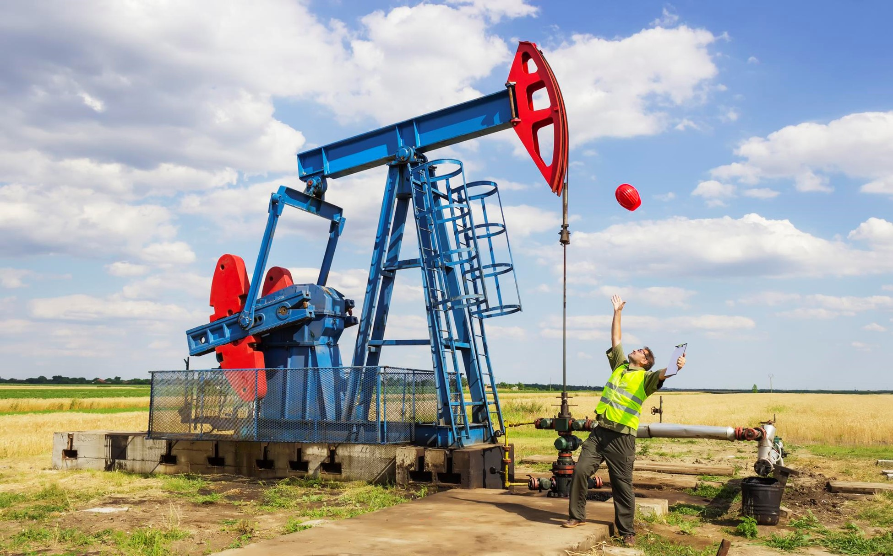
Introduction to SRP
SRP (Surface Rod Pumping) is a mechanical lift method used to extract oil from low-pressure reservoirs.
It consists of a motor-driven beam, sucker rods, and downhole pump.
Monitoring SRP operations helps identify inefficiencies, rod failures, and suboptimal strokes in real time.
ONGC uses digital oilfield initiatives to optimize production across its petroleum assets.
Gupta, P. (2024)

Slide 6
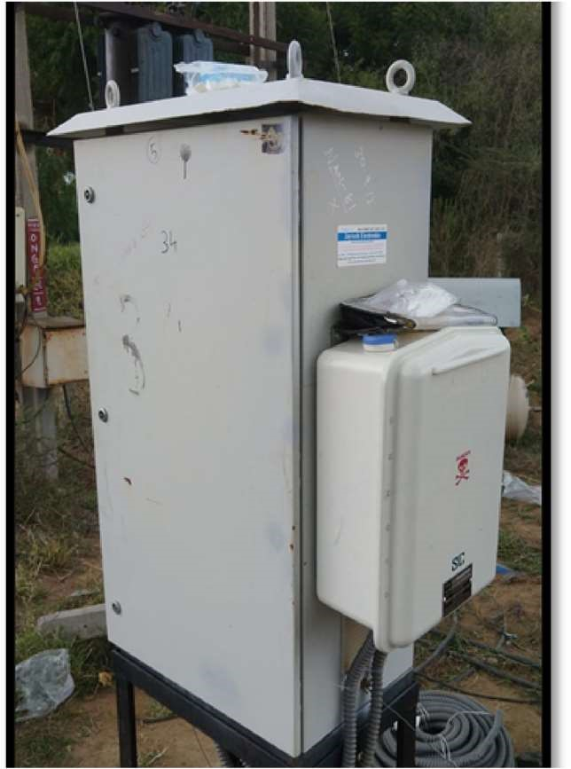
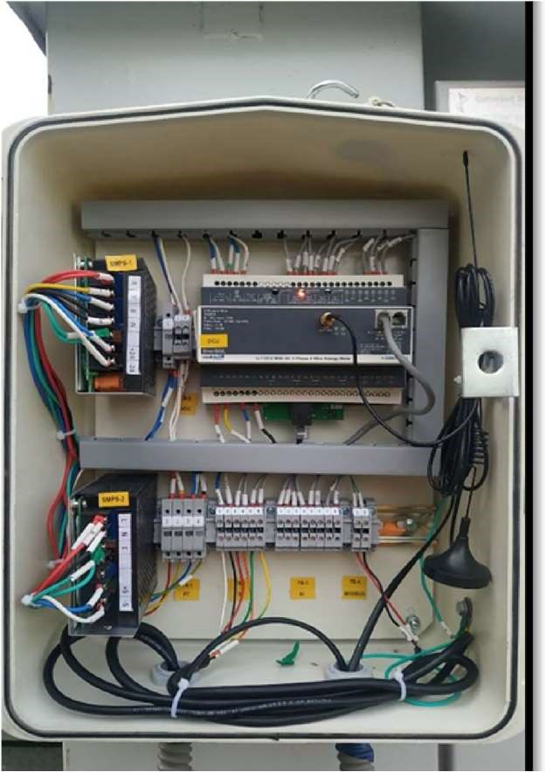
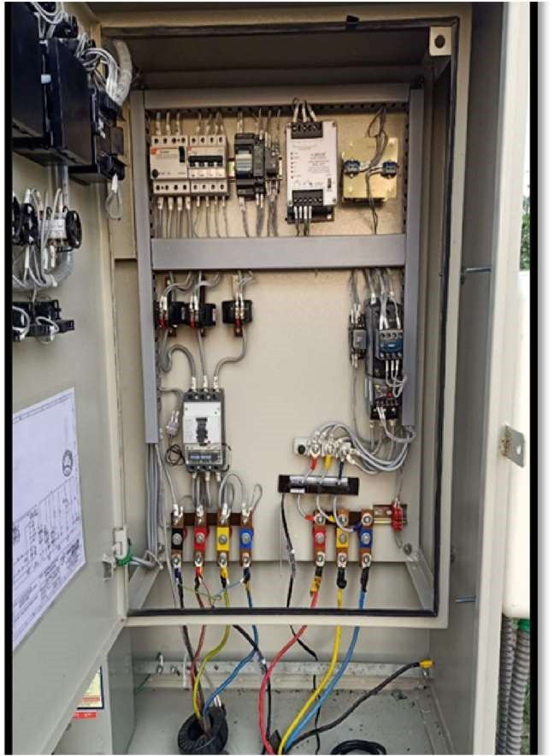
Real-time monitoring enables continuous tracking of SRP parameters such as:
Stroke length & speed
Polished rod load
Motor current & voltage
Wellhead pressure
Fluid level
Data is collected via sensors and transmitted through SCADA/IoT gateways to the control room.
Engineers can remotely monitor well performance through dashboards.
Real-Time Monitoring System
Chinchini
Bandra
Tapti
Panvel

Slide 7
Tools & Technologies Used
Component | Description
Sensors | Load cell, accelerometer, pressure & temperature sensors
Controller | PLC (Programmable Logic Controller)
Communication | IoT Gateway, Modbus, Ethernet
Software | ONGC RTDAS
Data Visualization | ONGC Digital Dashboard
Database | SQL-based historical data logger

Slide 8
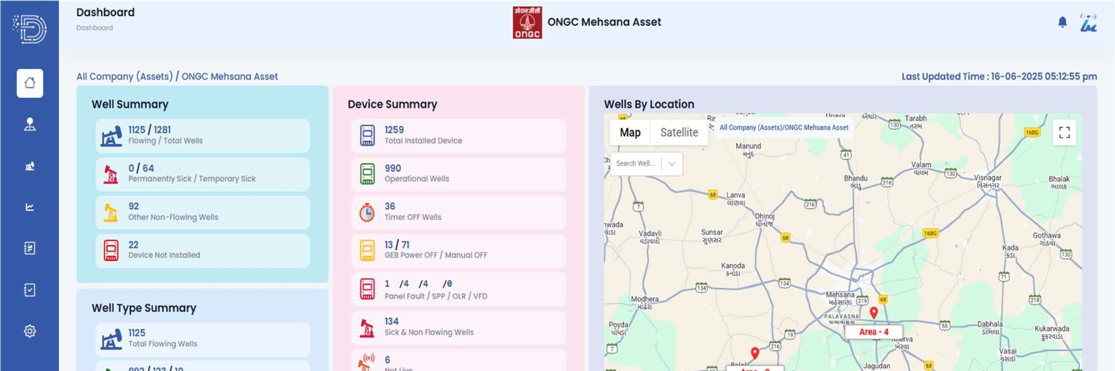
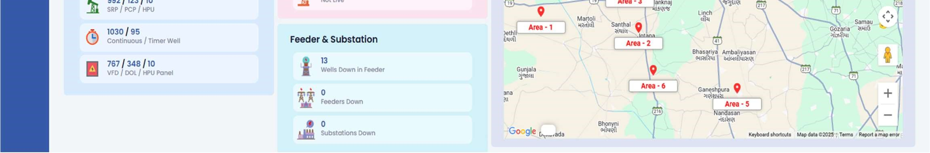
Implementation and Data Flow
1. Data Collection: Field sensors capture mechanical & electrical parameters.
2. Data Transmission: Values sent via Modbus/Ethernet to SCADA.
3. Processing: PLC converts signals into engineering units.
4. Visualization: Engineers analyze data on ONGC dashboards.
5. Decision Support: Alerts generated for pump failures or abnormal patterns.

Slide 9
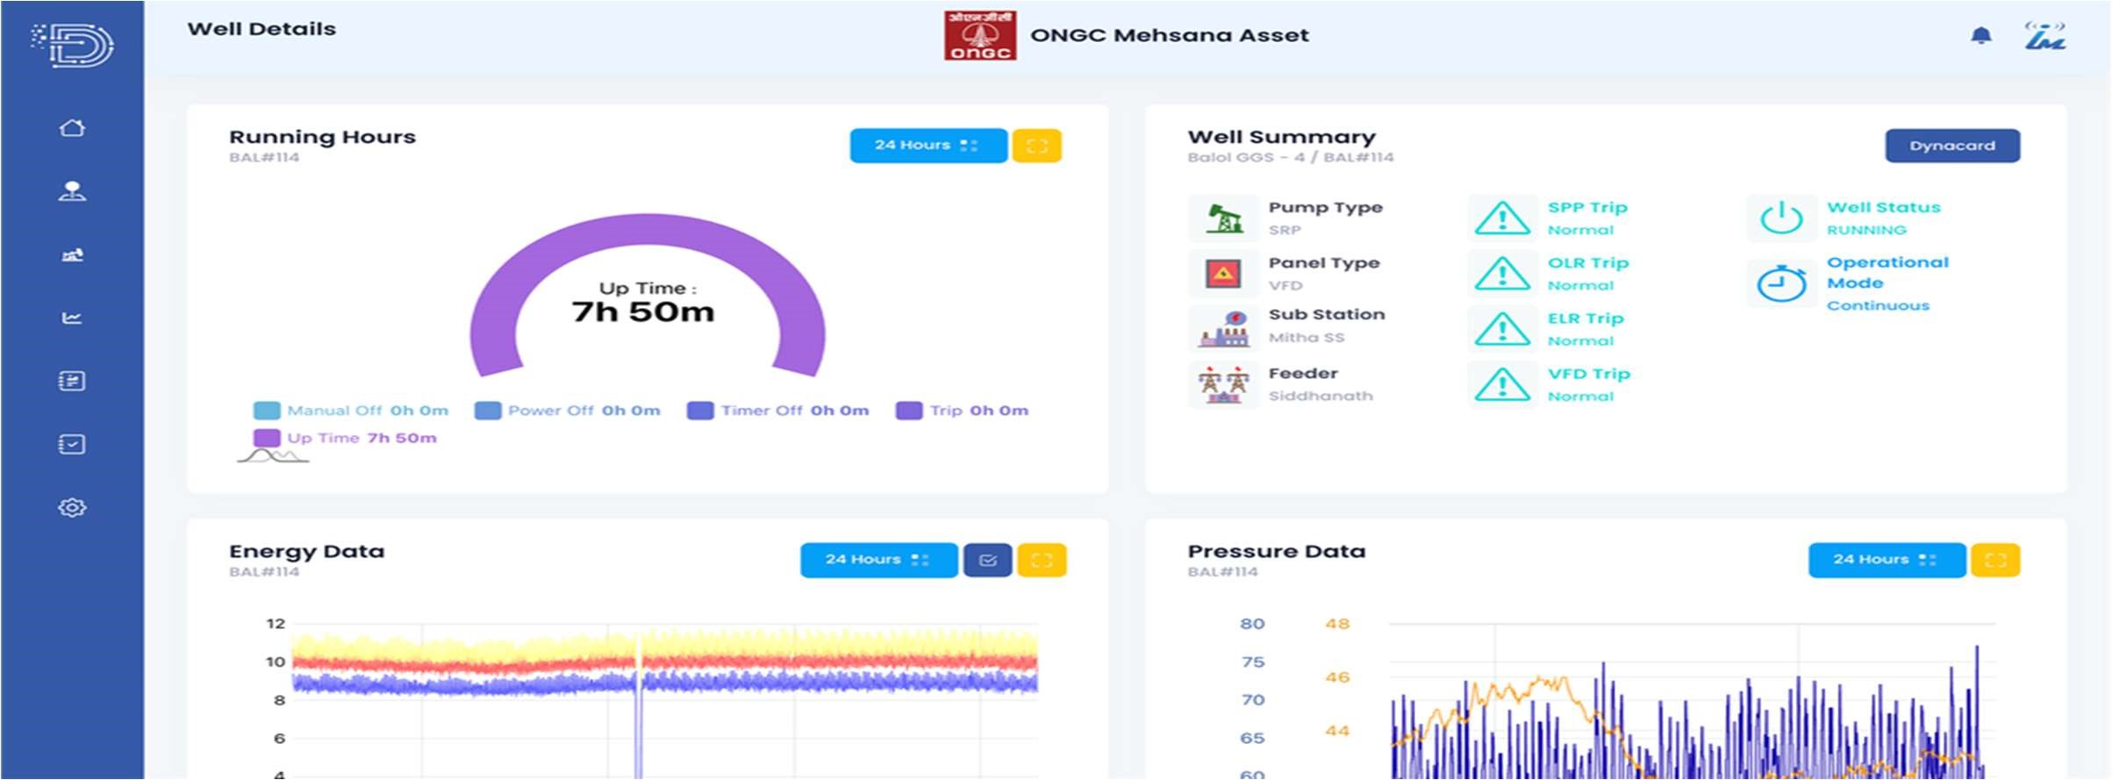
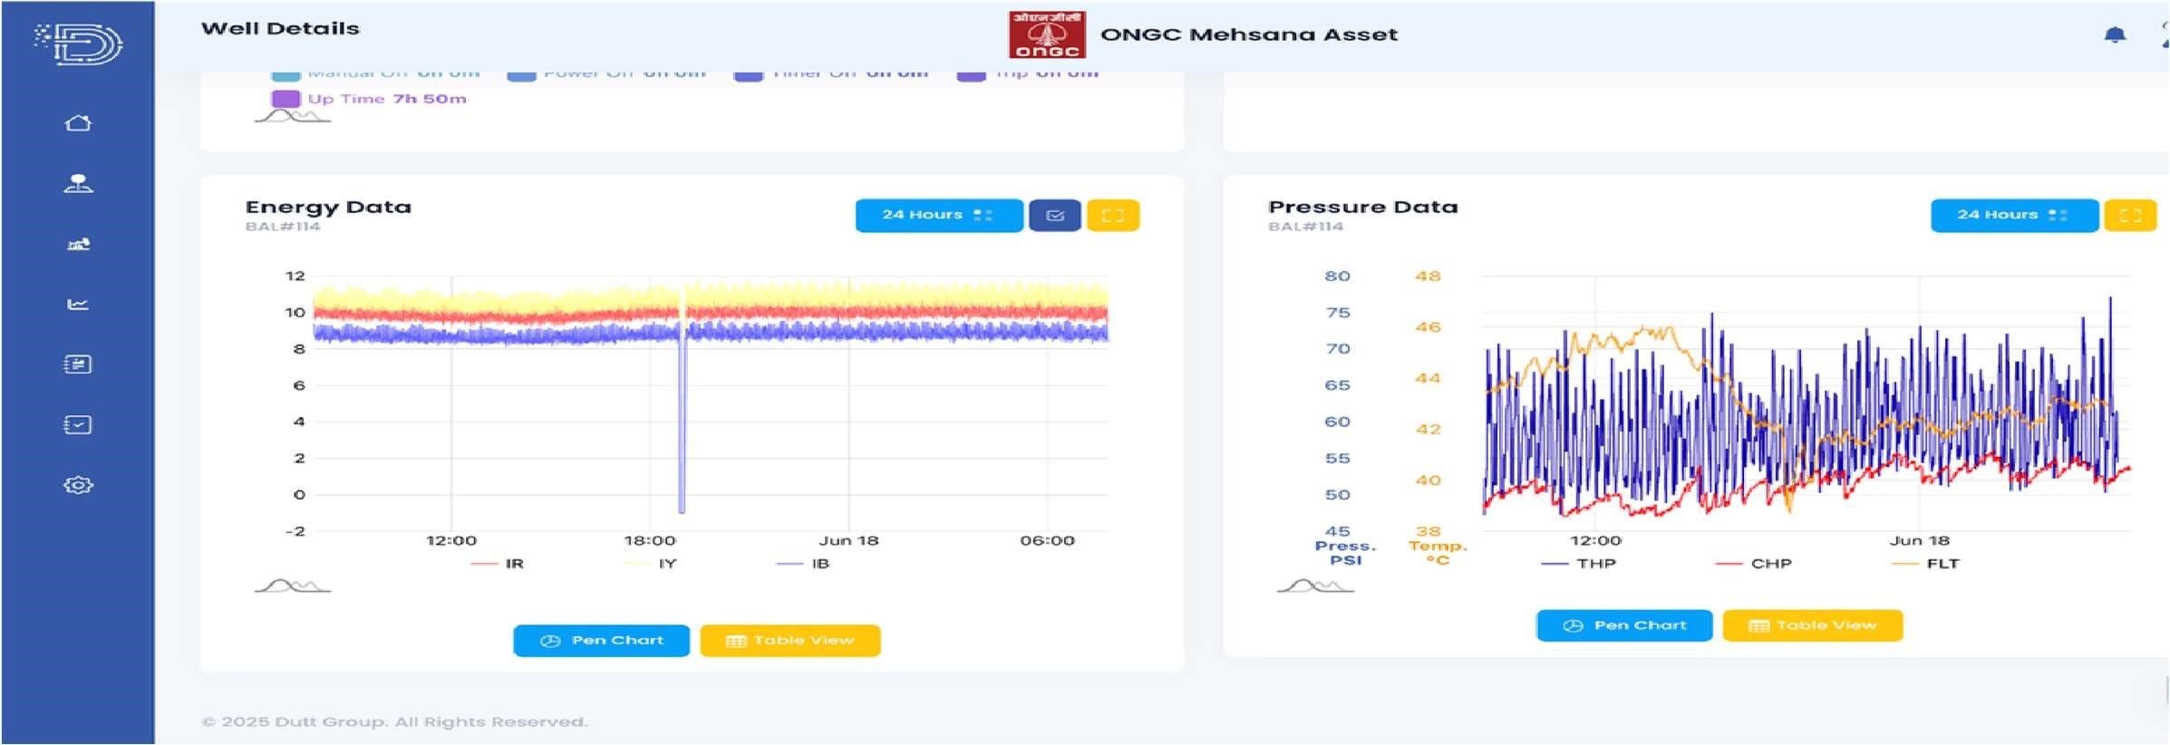
Observations and Results
Detected real-time load variations during downstroke and upstroke cycles.
Observed that pump efficiency improved by ~12% after real-time calibration.
Identified early rod failure alerts, preventing downtime.
System ensured data reliability and operational safety under remote conditions.
CONCLUSION

Slide 10
Challenges & Solutions
Challenge | Solution
Sensor calibration errors | Routine calibration and redundancy checks
Data transmission lag | Used edge processing before upload
Harsh field conditions | Weatherproof casing and vibration isolation
Integration with old SCADA systems | Implemented Modbus-TCP bridge for compatibility

Slide 11
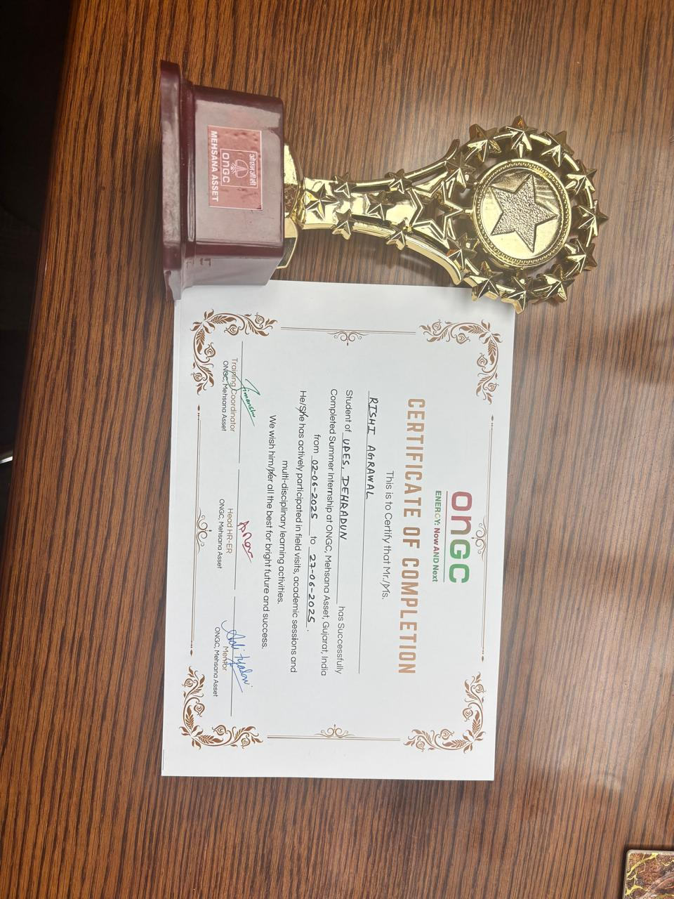
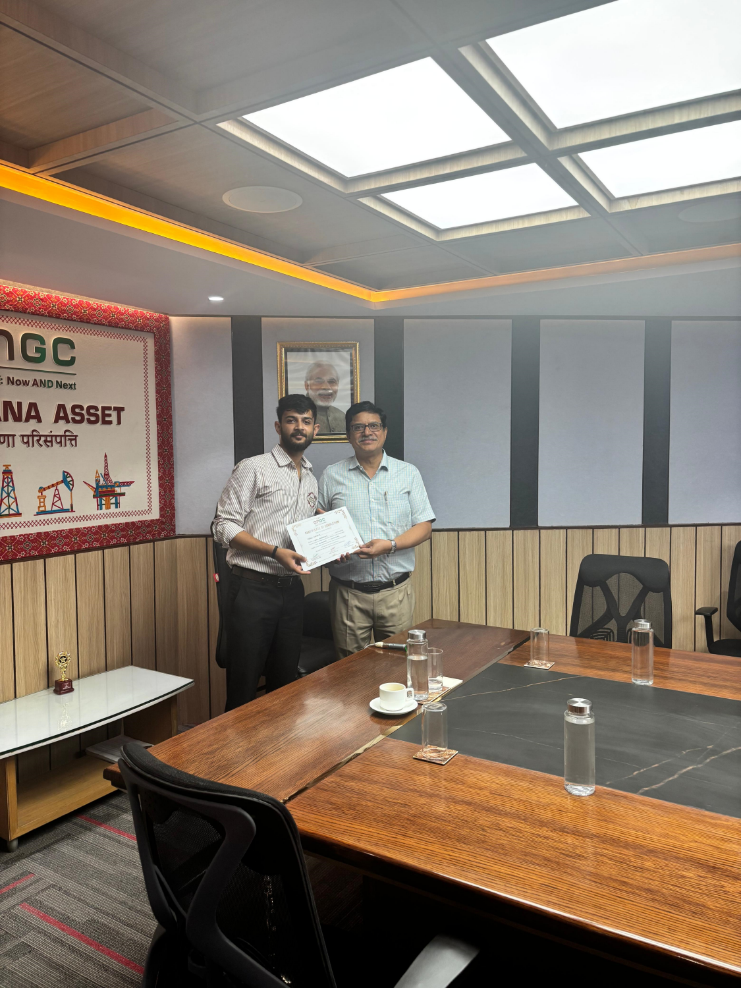
Experience and Exposure
Gained hands-on experience with real-time monitoring and automation systems.
Learned about data acquisition, PLC configuration, and dashboard visualization.
Understood the importance of HSE (Health, Safety & Environment) practices at oilfields.
Enhanced technical knowledge of digital oilfield systems and teamwork in a live environment.

Slide 12
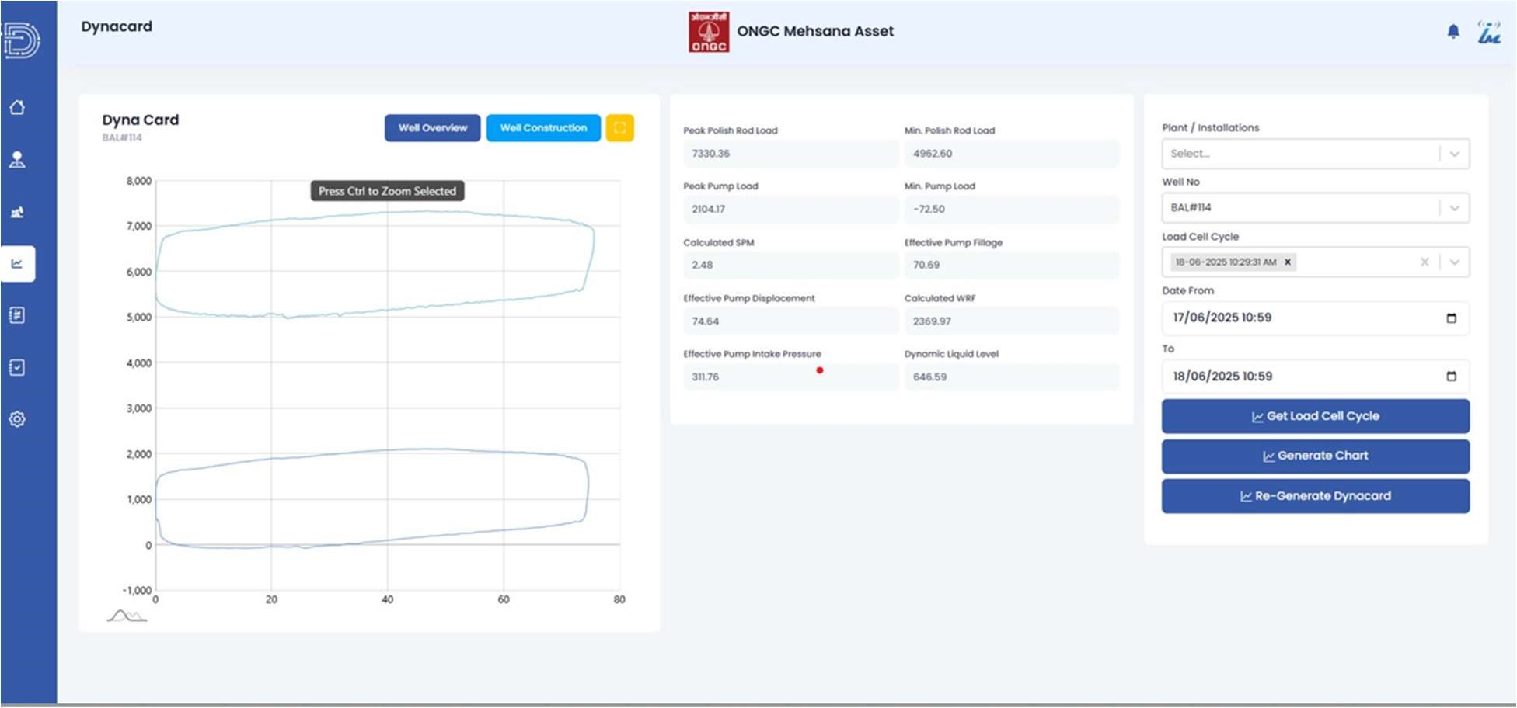
Conclusion
The internship enhanced understanding of digital monitoring technologies in petroleum operations.
Real-time systems play a vital role in maximizing uptime, ensuring safety, and improving efficiency.
The project aligns with ONGC’s “Digital Oilfield” and “Production Optimization” vision.

Slide 13
References
ONGC Internal Documentation – SRP Digital Monitoring Manual, 2025.
2. API RP 11L – Recommended Practice for Surface Pumping Units.
3. Gupta, P. (2024). Automation in Oil Production Systems. Petroleum Engineering Journal.
4. ONGC RTDAS User Manual, Mumbai Asset (2025).
5. Halliburton, Schlumberger (2023). Digital Oilfield Data Management Framework.

Slide 14
Thank You

